Slide 1


“Rock Paper Scissor”
Group Members
Mr. Devanshu Mahapatra (20104036)
Mr. Athul Nair (20104048)
Mr. Subhashish Mahapatra (20104049)
Course: Python
Month-Year: October-2021

Slide 2
CONTENTS
Introduction
Statement of Problem
Features/Functionality
Technology Stack
Graphical Representation
Conclusion

Slide 3
INTRODUCTION
The Project “Rock Paper Scissor” is developed in Python language.
It mainly focuses on creating a user friendly GUI based classical Rock Paper Scissor Game.
Using this application, a user can play a simple Rock Paper Scissor Game.

Slide 4
STATEMENT OF PROBLEM
Rock Paper Scissors Game using Tkinter.
We all know the game Rock Paper Scissors, right? It is one simple game that we all play with our hands. We will make a user interface in which we can place three buttons: Rock, Paper, and Scissors. Users of the app can press any button to make their choice. Rock Paper Scissors Game using Tkinter In this game, users will be playing against the computer. We will write Python code in the back-end so that the computer can also select its choice automatically.
It is a game with three choices: rock, paper, and scissors. Two players can play this game at a time. Each one has to choose from the three options available. So, both the user and the computer will choose their options. And then, we will apply the following rules.
If one player chooses the rock, and the other chooses the scissor, rock wins. If one player chooses the rock, and the other player chooses paper, paper wins. If one player chooses the scissor, and the other player chooses paper, scissor wins. If both the choices are the same, then no one will win. Both the user and the computer will not get any points.

Slide 5
FEATURES
To provide a user friendly GUI based classical Rock Paper Scissor Game using Python and Tkinter
Using this application, a user can play a simple Rock Paper Scissor Game.

Slide 6
TECHNOLOGY STACK
Language: Python Version 2.7.16
IDE: Thonny Version 3.3.13

Slide 7
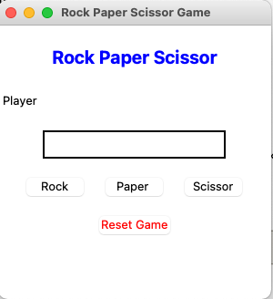
GUI INTERFACE

Slide 8
Conclusion
Thus, we have designed a classical Rock Paper Scissor Game using Python and Tkinter, which is enjoyable and user friendly.

Slide 9
THANK YOU!

